Slide 1

MECHATRONIC SYSTEMS ENGINEERING SEMESTER PROJECT
TEAM UNKNOWN
Vignesh Arumugam – 7213710
Nijat Dashdamirov - 7213892
Namık Mert Tunçbilek – 7213712
Omar Mammadov - 7213766

Slide 2
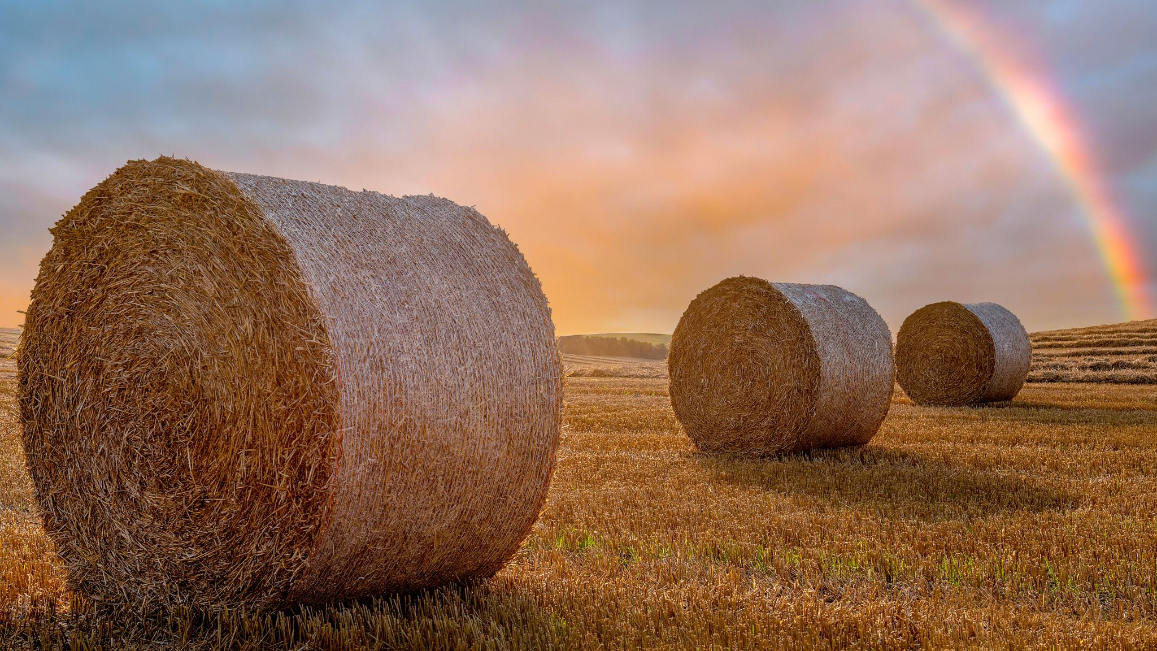
Task
Collecting the bales of straw and bringing them to a certain location using different type of vehicles autonomously
Server-Side Duty
Server know about the field
Server decide the need for the vehicle type change
Server update the vehicle with bale’s node coordinate
Vehicle Duty
Vehicle decides the path
Vehicle avoid obstacles

Slide 3

Used types of vehicles
1 Small vehicle
1 Medium vehicle
1 Large vehicle
1 Weed Vehicle

Slide 4
CONSENS
Environment analysis
Active structure
Requirements
Hierarchy of functions
Application scenarios
Behaviour definition

Slide 5
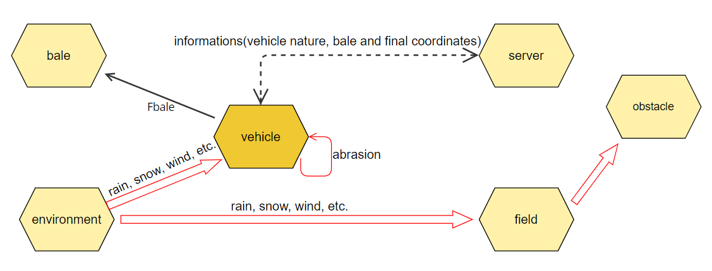
Environment Analysis

Slide 6
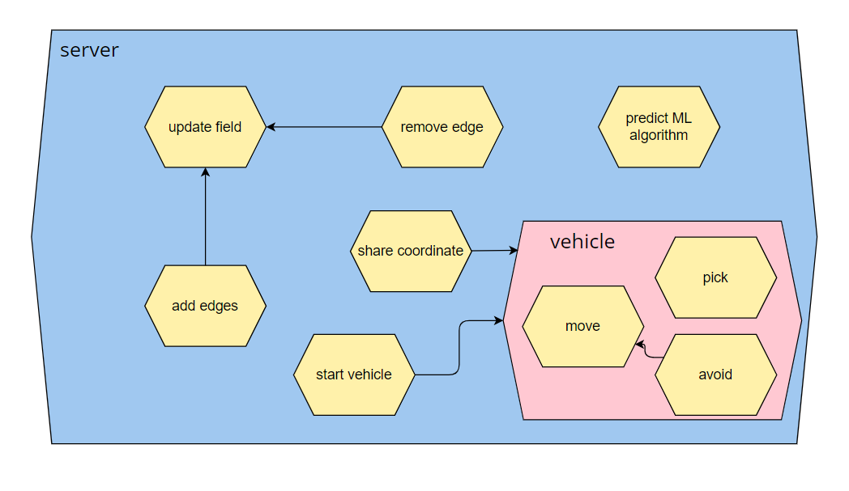
Active Structure

Slide 7
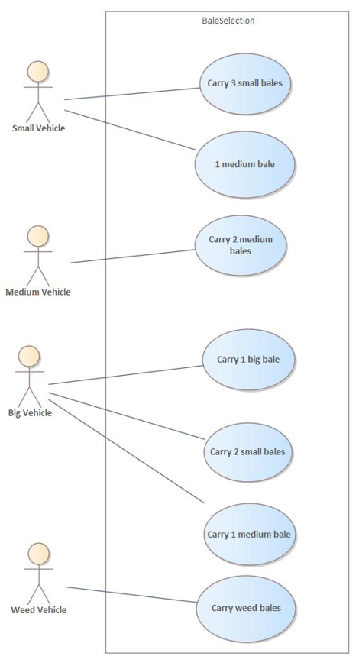
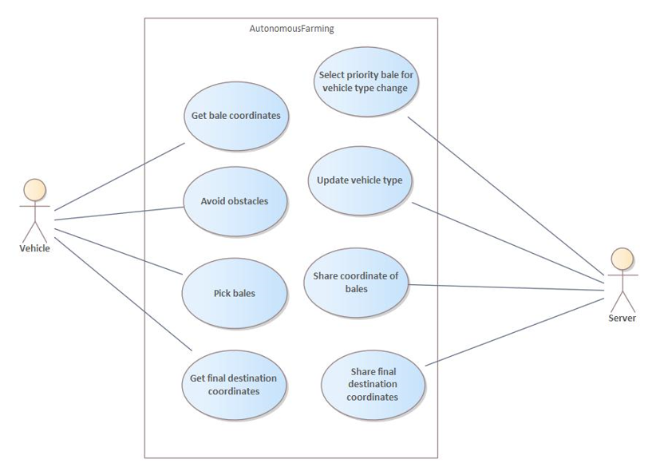
Application Scenarios

Slide 8
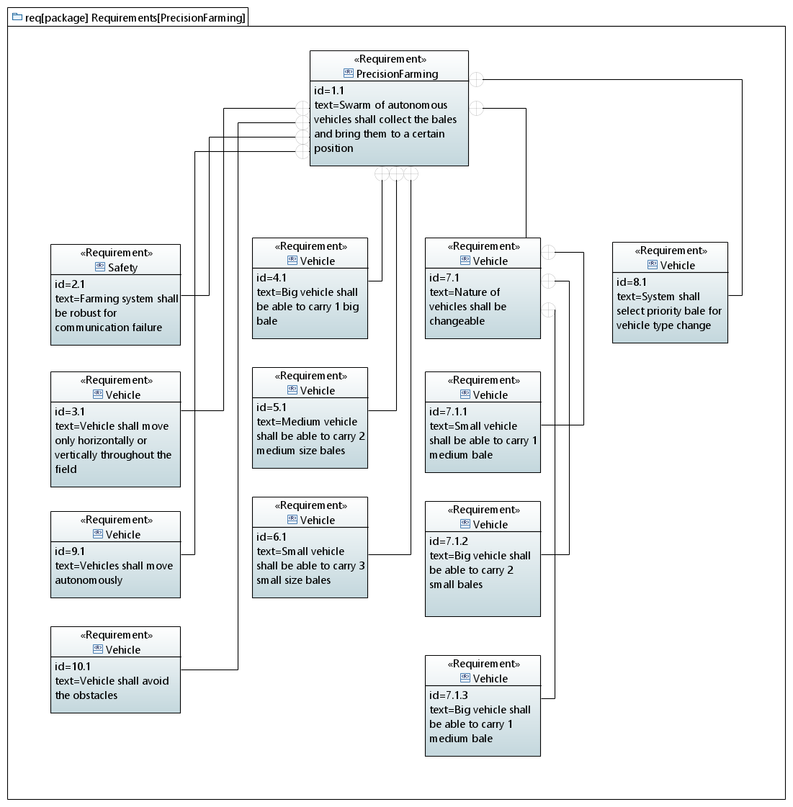
Requirements

Slide 9
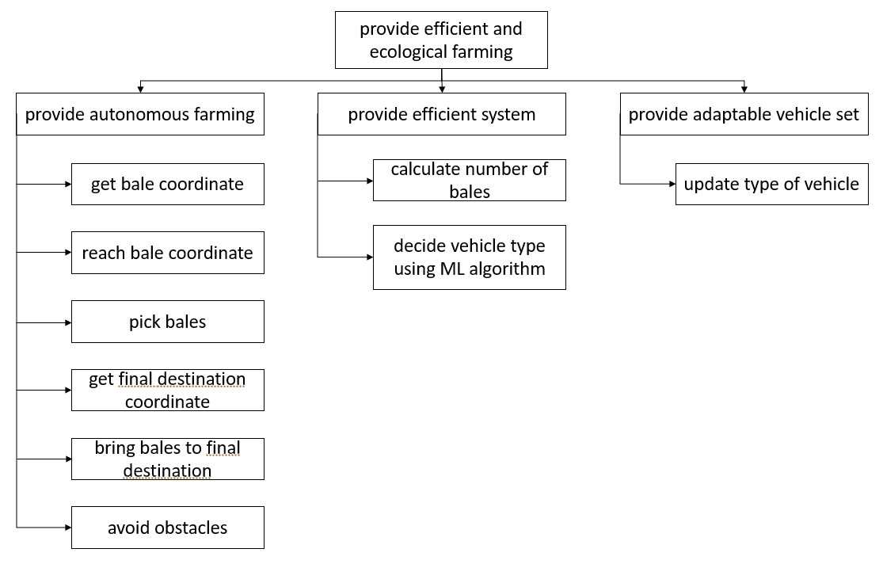
Hierarchy of Functions

Slide 10
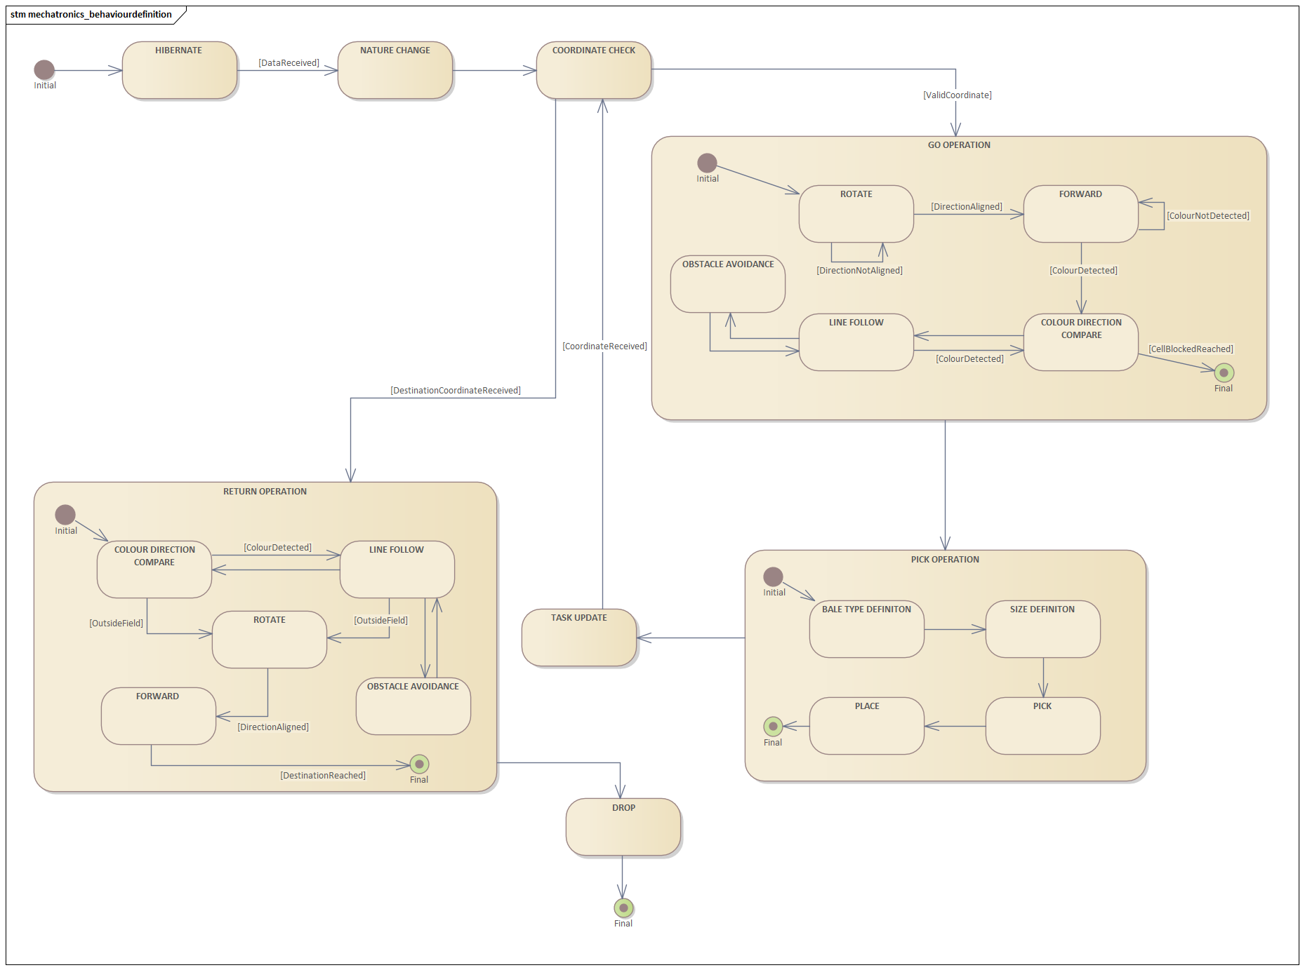
Behaviour Definiton

Slide 11
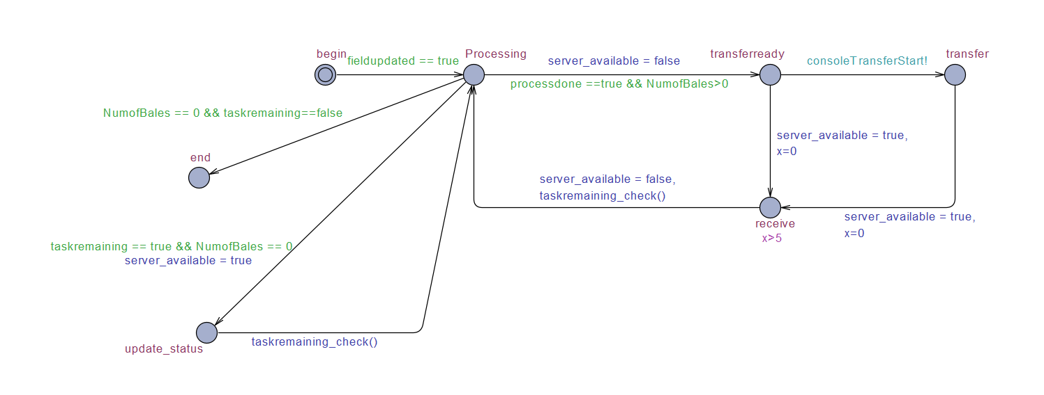
UPPAAL
Server Model

Slide 12
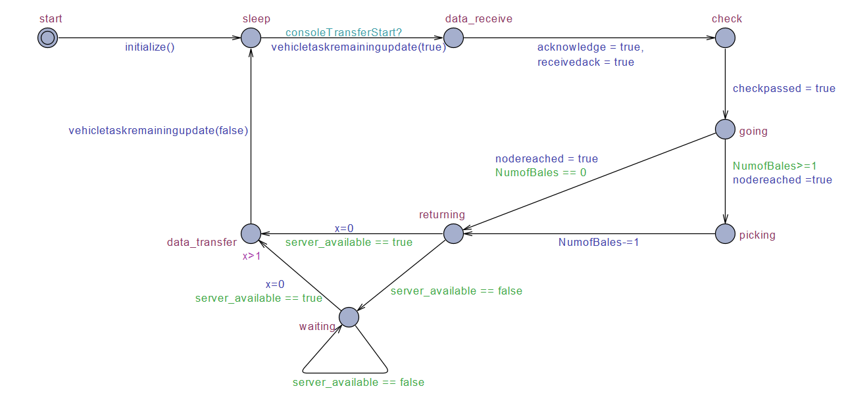
UPPAAL
Vehicle Model

Slide 13
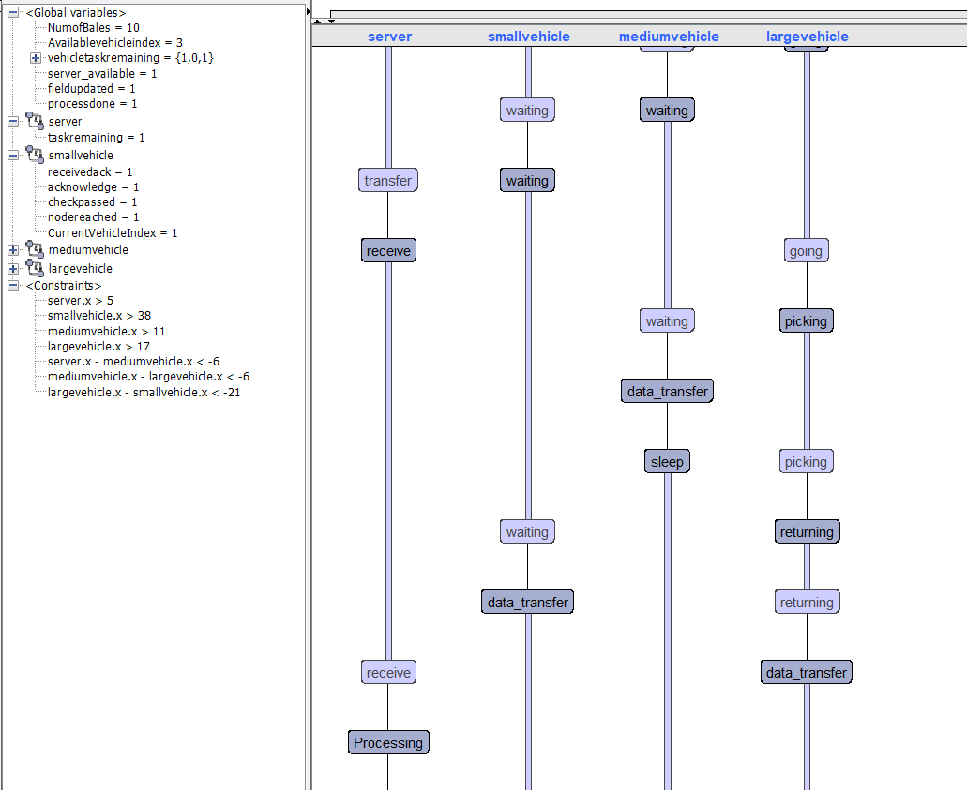
UPPAAL

Slide 14
UPPAAL
Verification
A[] not deadlock

Slide 15
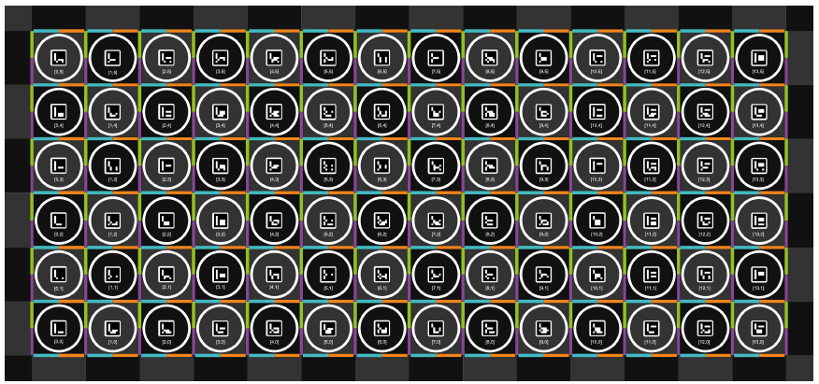
Coding Algorithms
Edge Creation

Slide 16
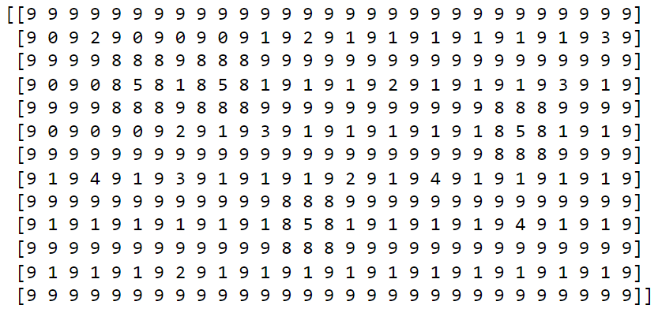
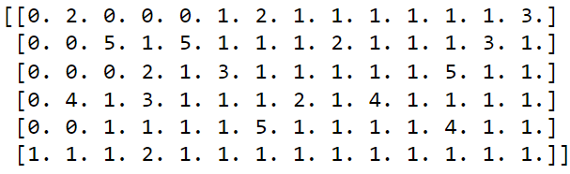
Coding Algorithms
Edge Creation

Slide 17
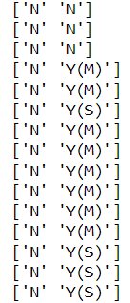
Coding Algorithms
ML support

Slide 18
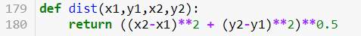
Coding Algorithms
Shortest Distance

Slide 19
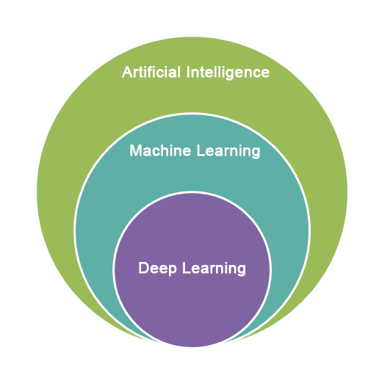
Implementation of ML Algorithm
Goal of the Machine Learning is to build a computer system that can easily adapt and learn from data
As it is increasing efficiency over time and in each iteration, it can be said like computer is learning

Slide 20
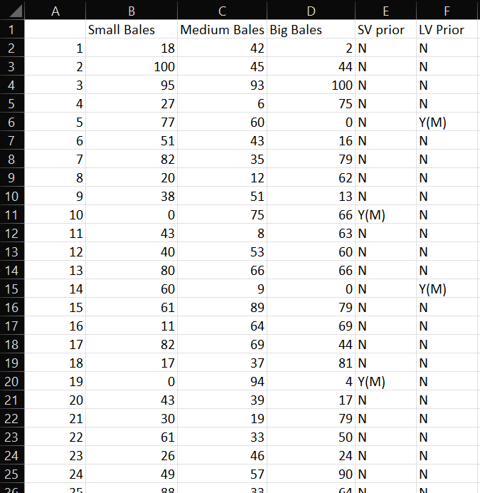
ML Training Dataset

Slide 21

Implementation of ML Algorithm(Decision tree)
Decision tree is a algorithm that utilizes tree-like model to divide the data into clusters.
It has following components:
Root nodes
Sub-Tree
Decision Nodes
Leaf Nodes ---> main component.

Slide 22
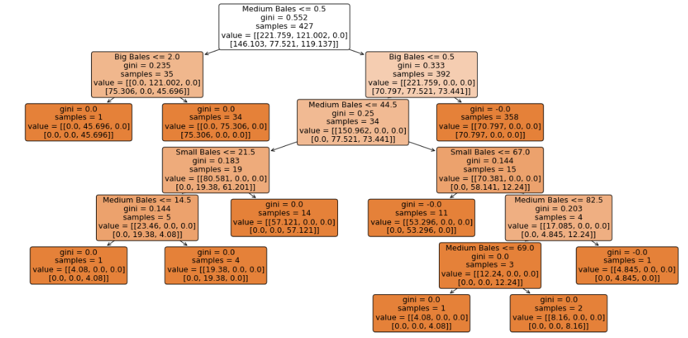
Implementation of ML Algorithm

Slide 23
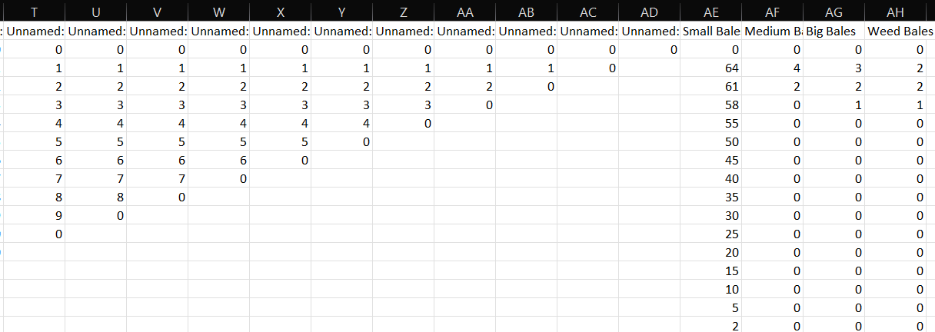
ML Prediction Table

Slide 24
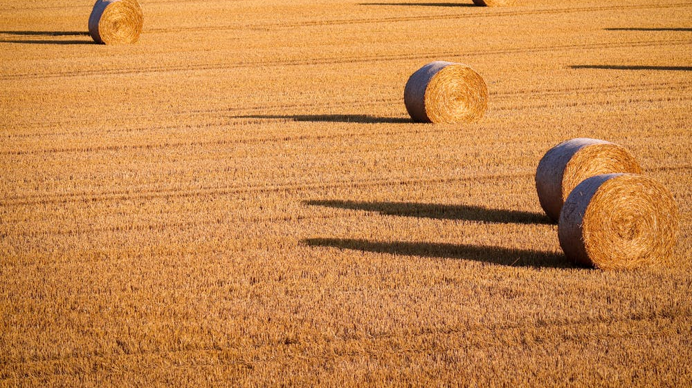
References
[1] Gausemeier (2014), Design Methodology for Intelligent Technical Systems ,Develop Intelligent Technical Systems of the Future.
[2] J.Gausemeier , U.Frank , J.Donoth,S.Kahl, (2009), Specification technique for the description of selfoptimizing mechatronic systems

Slide 25
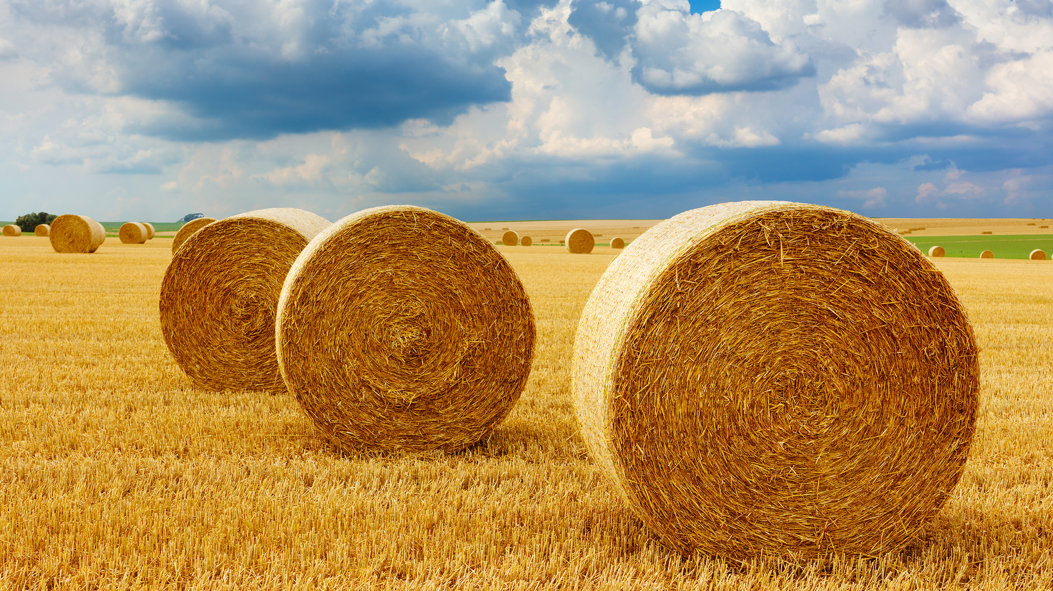
THANK YOU!

